Slide 1




Git Basics
By Emilio Tonix

Slide 2
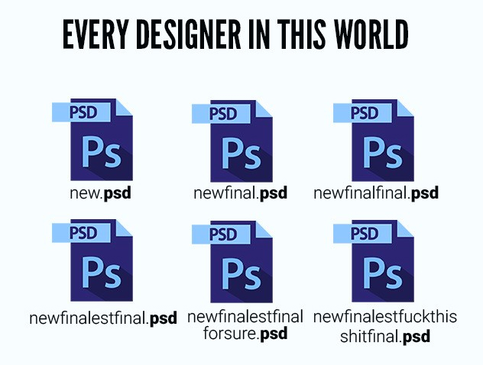
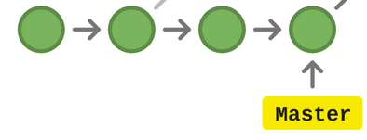
What is git?
It is a version control system. Avoid multiple local and confusing copies and bad file tracking. Project will be on a track time line system. Each checkpoint has a unique TAG and a comment.

Slide 3


Where is git?
Local
Remote
Local: You have your tracking on your PC. If your PC is lost your project is too.
Remote: Use a git tracker service like, github, git lab or bit bucket.
We usually have both of them at the time.

Slide 4

Files Status
Push
Commit
Stage
Unstage

Slide 5

Files Status
Unstage: This is by default when changes are made. Git detects when files have new data, it compares the last commit checkpoint.
Staged : Files selected are almost ready to make a checkpoint. Is not a must to stage all files.
Commit : Add a comment to all staged files. At this point the checkpoint is set.
Push: Upload your commit at the remote repository. Now you have a doble backup. You can upload multiple local commits at the time.

Slide 6
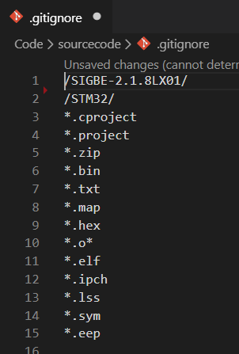
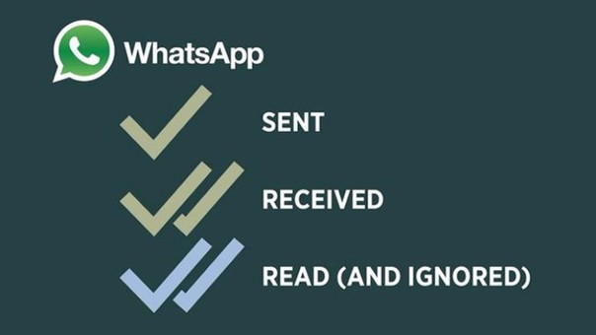
Git ignore
They are some files you may not want to track. So add them into a black list.

Slide 7
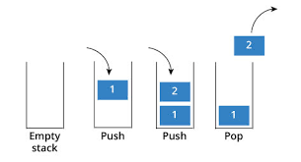
Git stash
Save your local changes in a temporary folder. Then you can change some code and get back to that temp folder if needed. Your temp changes are saved in a stack way. To get your last stashed changed you have to pop it.
$ git stash
$ git stash pop

Slide 8

Git pull
Maybe your local repo is not up to date. You should pull changes.
Warning!!!! git pull is the more aggressive alternative, it will download the remote content for the active local branch and immediately execute git merge

Slide 9

Git fetch
It will download the remote content but not update your local repo's working state, leaving your current work intact.Git pull will overwrite local
Is useful when your branch is not up to date and they may be conflicts in synchronization.
git fetch <link> feature_branch

Slide 10
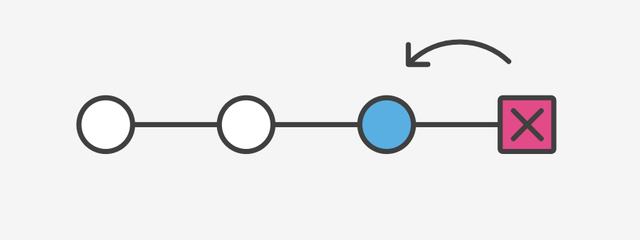
Git reset
Deletes the commit ID permanently. And goes back in time.
git reset --hard: Discards local changes, you may don't want.
Git reset --hard commit_id

Slide 11
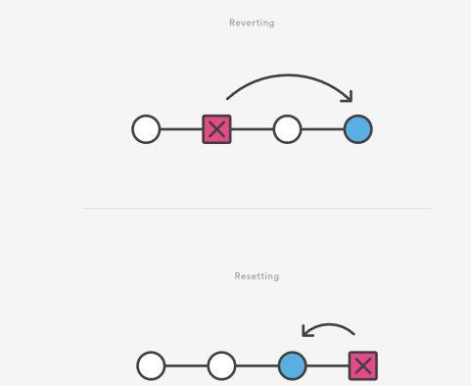
Git revert
Deletes changes in a safety mode, this means that is keeping tracking of the unwanted commits, instead of deleting them all. Is a way to save mistakes that could be useful in the future.

Slide 12
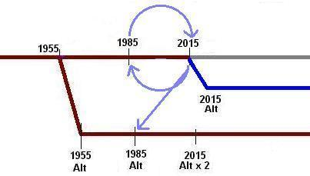
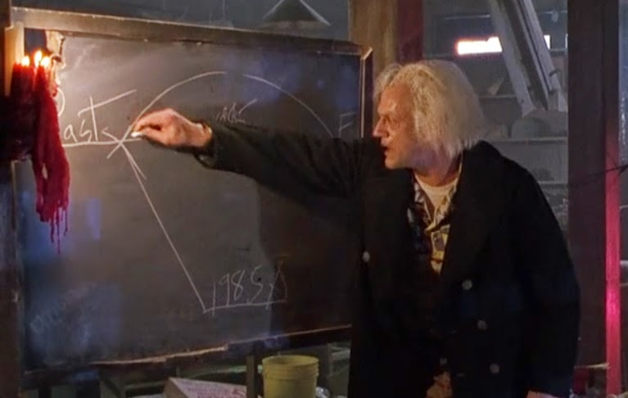
Git allows time travel.
You can get back at certain time in past, where things were good and worked. Go to old commits and checkout the past.

Slide 13


Slide 14

Git branches
Branches allow to have multiple versions of an original version set. It creates a new subset without affect the original one. The are some conventions commonly used.

Slide 15
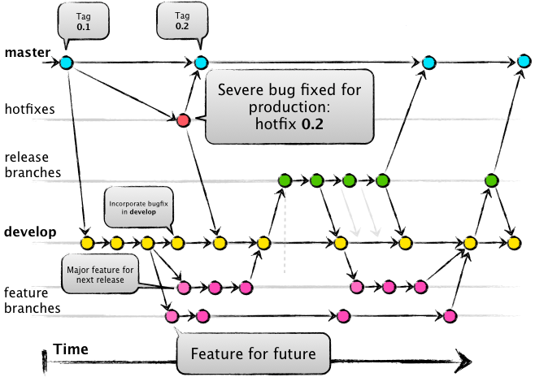
Git flow
Used for team development.

Slide 16

Git merge
Each developer should have one branch for feature, or working set.
Merge all the necessary branches, to release product version.

Slide 17
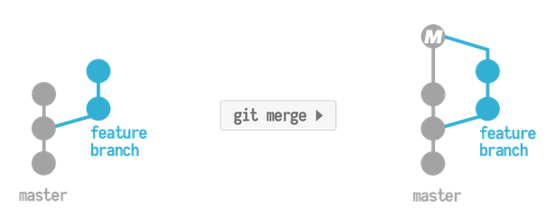
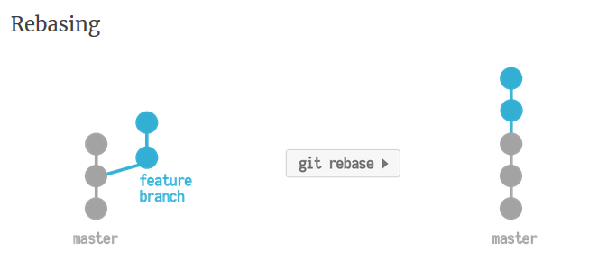
Git rebase
It will move forward the feature branch commits, it will not create a new commit as merge.

Slide 18
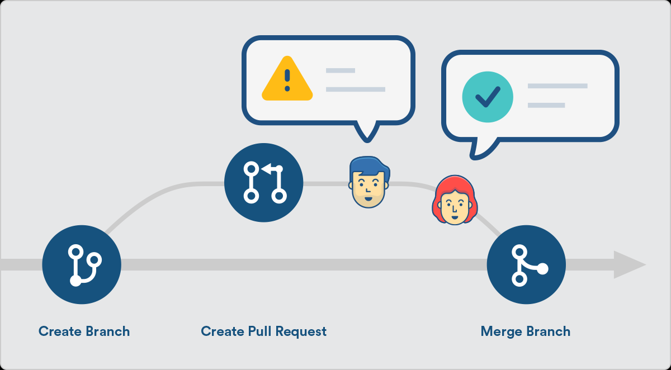
Git pull request
Don’t confuse it with git pull. A pull request is a way to join branches in an authorized an supervised way.

Slide 19
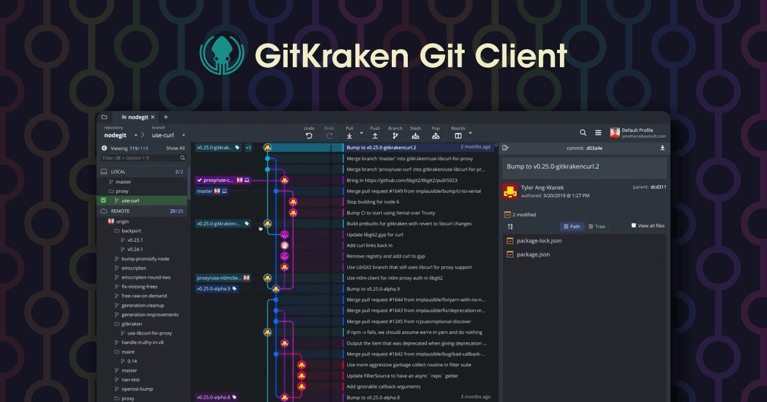
Tools

Slide 20

Git commands
Git init: initialize an existing directory as a Git repository
Git log: check commits.
Git add: stage changes
Git commit -m “message” : checkpoint staged files
Git push : add local commits to the remote.
Git pull : pull remote changes
Git checkout: move to certain branch or commit.
Git branch -a: show all branches
Gitk: basic git GUI monitor.

Slide 21

Upload your local repo
$ git remote add origin <remote repository URL>
$ git remote -v
# Verifies the new remote URL
git push origin master

Slide 22
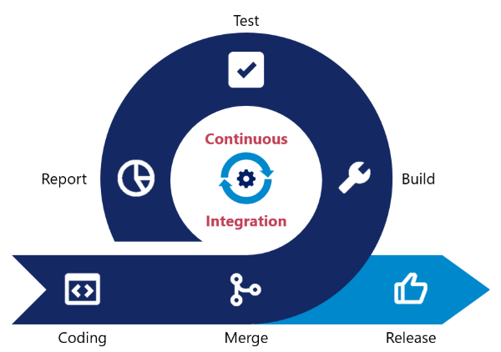
What is next?

Slide 23
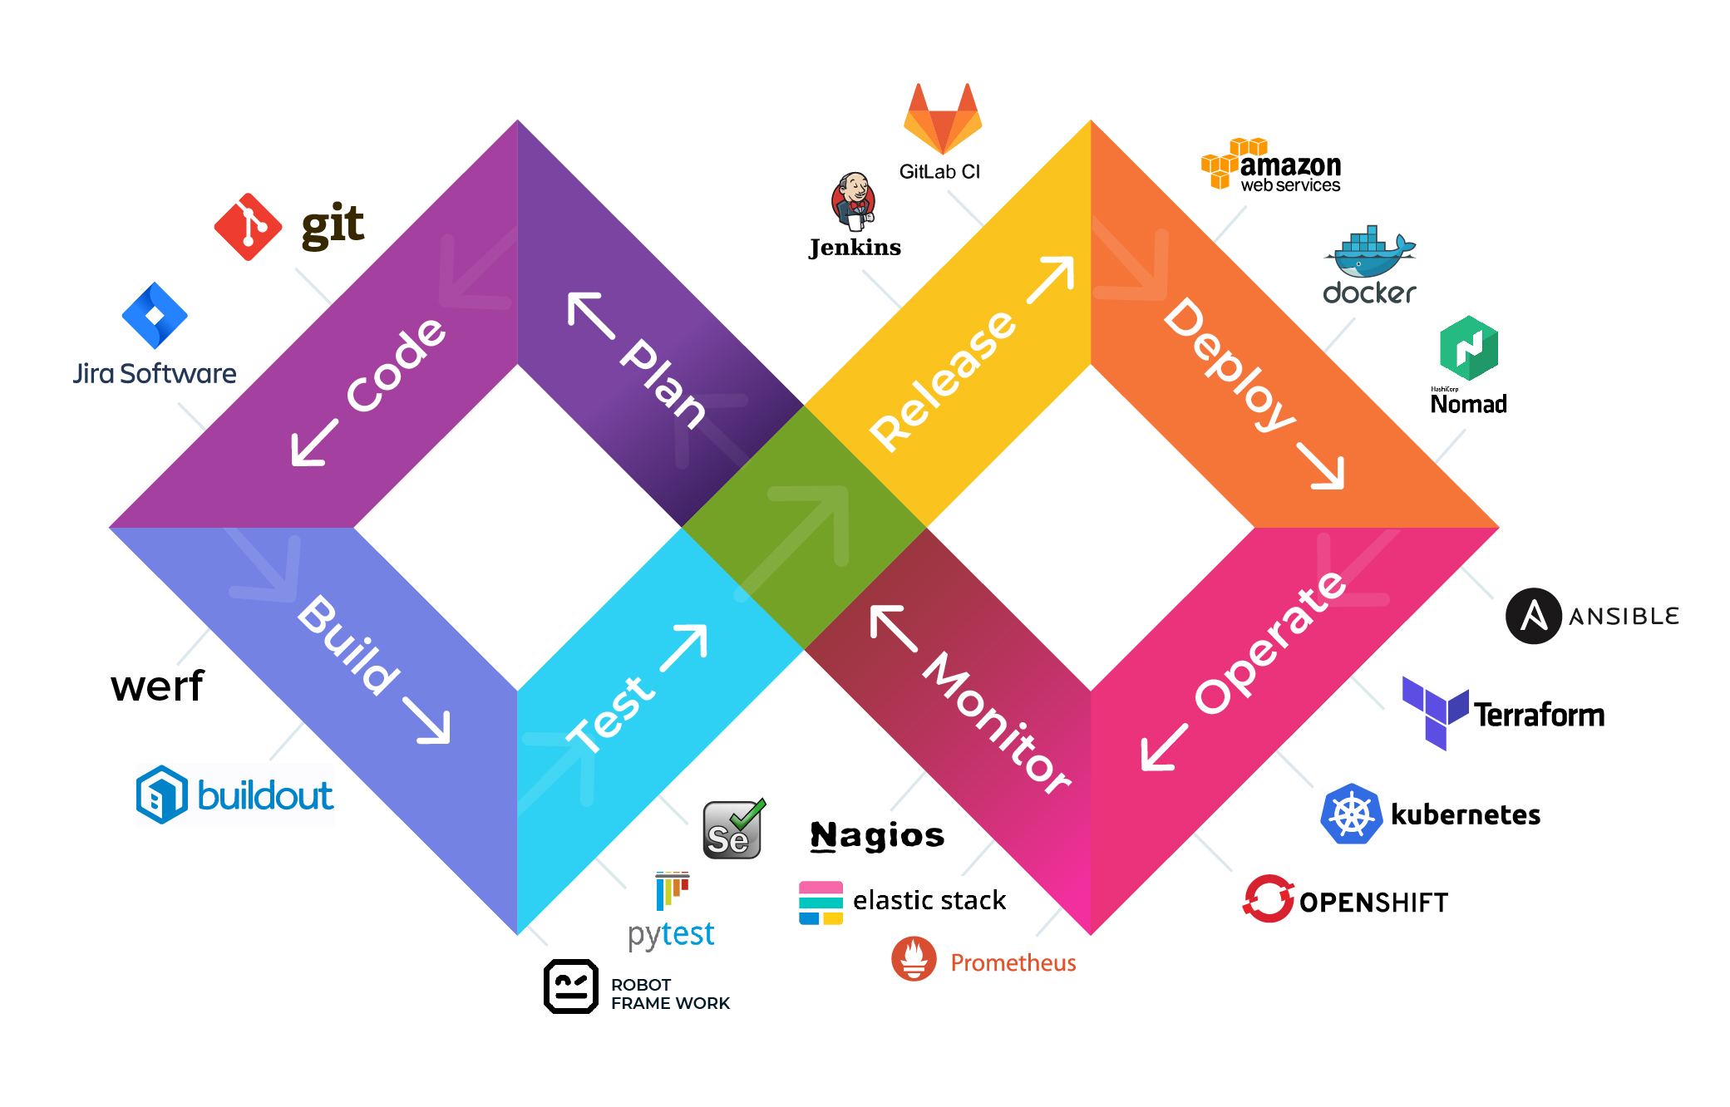

Slide 24
References
Tutorial and examples
https://www.atlassian.com/git/tutorials/learn-git-with-bitbucket-cloud
Git commands
https://education.github.com/git-cheat-sheet-education.pdf
https://dev.to/dhruv/essential-git-commands-every-developer-should-know-2fl
Rebase
https://www.themoderncoder.com/a-better-git-workflow-with-rebase/

Slide 25
References
Git flow
https://www.atlassian.com/git/tutorials/comparing-workflows/gitflow-workflow
Pull request
https://www.atlassian.com/blog/bitbucket/5-pull-request-must-haves

